Slide 1
Problem statement number #8 DeepFake detection with MesoNet ⭐👨‍💻
MesoNet is a convolutional neural network dedicated to identifying deep fakes. It effectively manages noise produced by low-quality video processing, ensuring accurate analysis.

Slide 2

Swami Keshvanand Institute of Technology, Jaipur
Major Project on: Detecting DeepFakes
Team Name : Quadcode
Team Leader : Bhavya Goyal - Integrating different tools and techniques for detecting Deepfakes
Team member 1 : Prashant Sharma - Analyse the classifier data with model accuracy
Team member 2 : Priyanshu Batra – Provide the real and deep fake data for detection
Team member 3 : Rahul Chaudhary – Analyse the project and provide the support for project implementation

Slide 3
Introduction : Deepfakes refers to realistic, computer-generated manipulations of image, video, or other digital representation. The term is a combination of "deep learning" and "fake." Deep learning involves the use of neural networks, a type of machine learning model inspired by the human brain, to analyze and learn patterns from vast amounts of data.
Deepfakes have gained attention and concern because of their potential misuse, such as creating misleading or malicious content that can be difficult to distinguish from real footage
Recently, we see deepfake videos of famous personalities like Sachin Tendulkar and Rashmika Mandana on which they take concern by saying this is the misuse of technology and we don’t let this happen…it is harmful and all

Slide 4
Objective : The main objective of this project is to detect various deepfake images having fake expressions Our main motive is to compare the deepfake data with real data to predict the classifier data.
Deepfakes can be used to create content that looks remarkably authentic, making it difficult for the naked eye to differentiate between real and manipulated images.
As a result, there is a growing need for advanced technologies and tools, including deepfake detection algorithms, to help identify the impact of misleading content.
Key features :-
Framing
Feature extraction
Feature selection
Classification

Slide 5
Applications of Deep Fake detection:
Media and News : Deep fake detection plays a crucial role in ensuring the authenticity and integrity of media content, specially in journalism and reporting.
Legal and Forensic : Law enforcement and investigative agencies benefit from deep fake detection in verifying evidences
Entertainment Industry : Deep fake detection technologies are utilized to protect the identity and reputation of celebrities and public figures in the entertainment sector.
Online Platform and Social Media : Platforms implement deep fake detection to comat the spread of misleading and fabricated content, safeguarding users from misinformation.

Slide 6
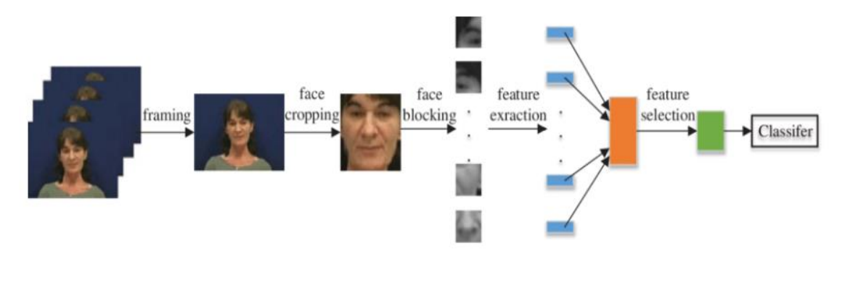
Software and technology :- Language – Python Frameworks – Tensorflow, keras, matplotlib, numpy, OpenCV Platform – Jupyter notebook Working flow of Deepfake detection

Slide 7



Functional Requirements : MesoNet – A key component : MesoNet is a convolutional neural network dedicated to identifying deep fakes. It effectively manages noise produced by low-quality video processing, ensuring accurate analysis. Tensorflow : In the context of deepfake detection, TensorFlow can be employed to develop and implement deep neural network models that can analyze and identify patterns indicative of manipulated or synthetic content. Keras : Keras is the high-level API of the TensorFlow platform. It provides an approachable, highly-productive interface for solving machine learning (ML) problems, with a focus on modern deep learning. Keras covers every step of the machine learning workflow, from data processing to hyperparameter tuning to deployment.

Slide 8
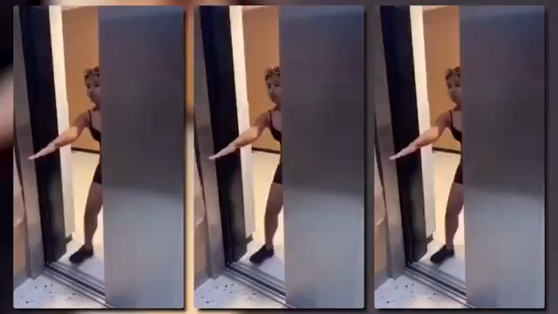
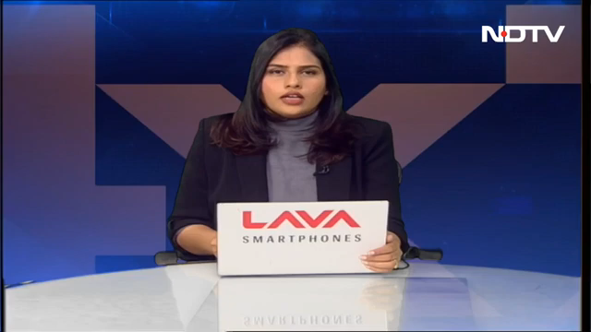
Why we choose deepfake detection? I guess, you all see the deepfake video of sachin Tendulkar and Rashmika Mandana, if not then let me show you.

Slide 9
I’m confident that you would recognize these fake videos as authentic and can’t find any disruption in the videos, this is the power of deepfake and AI which is now becoming dangerous. Our hon’ble PM also expressed concern on this problem. Now you can imagine if this is the problem then how much it can tarnished the identity of an individual. So that’s why we choose this problem statement and trying our best to help Rajasthan Police.
Advantages of deepfake detection:
Although it is harmful for famous public figures and influencers but it has some advantages also.
Enhancing Cybersecurity: Deepfakes can be used for cyber-attacks, including social engineering. Detecting these manipulations is essential for maintaining the integrity of communication systems and preventing security breaches.
Preventing Misinformation and Disinformation: Deepfake technology can be misused to spread false information, fake news, and malicious narratives. Detection tools can mitigate the impact of deepfakes by identifying and removing manipulated content, thereby helping to prevent the spread of misinformation.

Slide 10
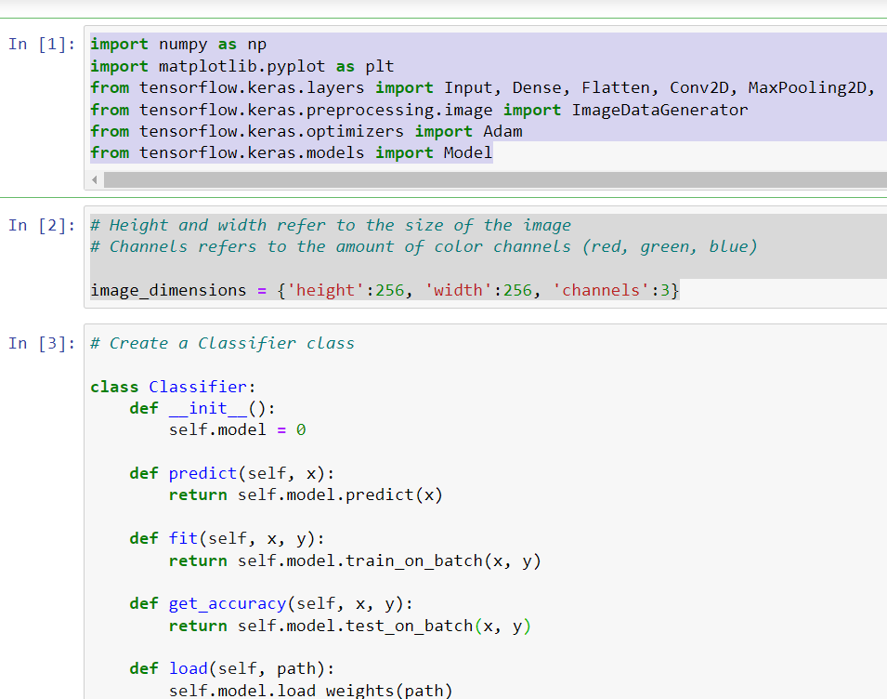
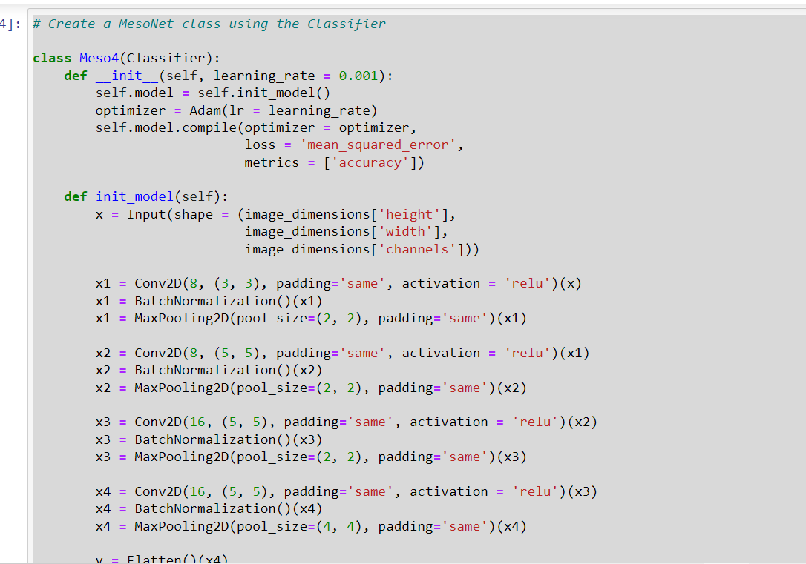
Progress update: We have done working on the detection model by taking the deepfake and real data in the form of images and then we process the classifier data analysis which shows the relation between deepfake and real images.
Here are some code snippets :

Slide 11
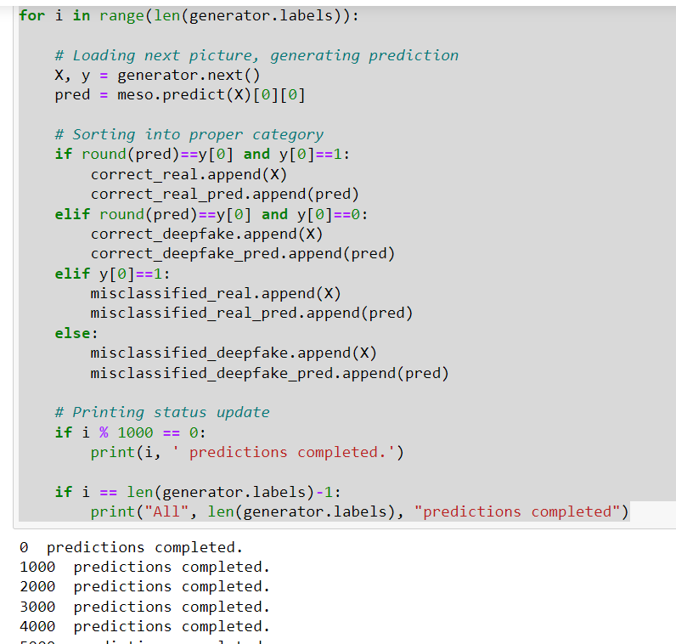
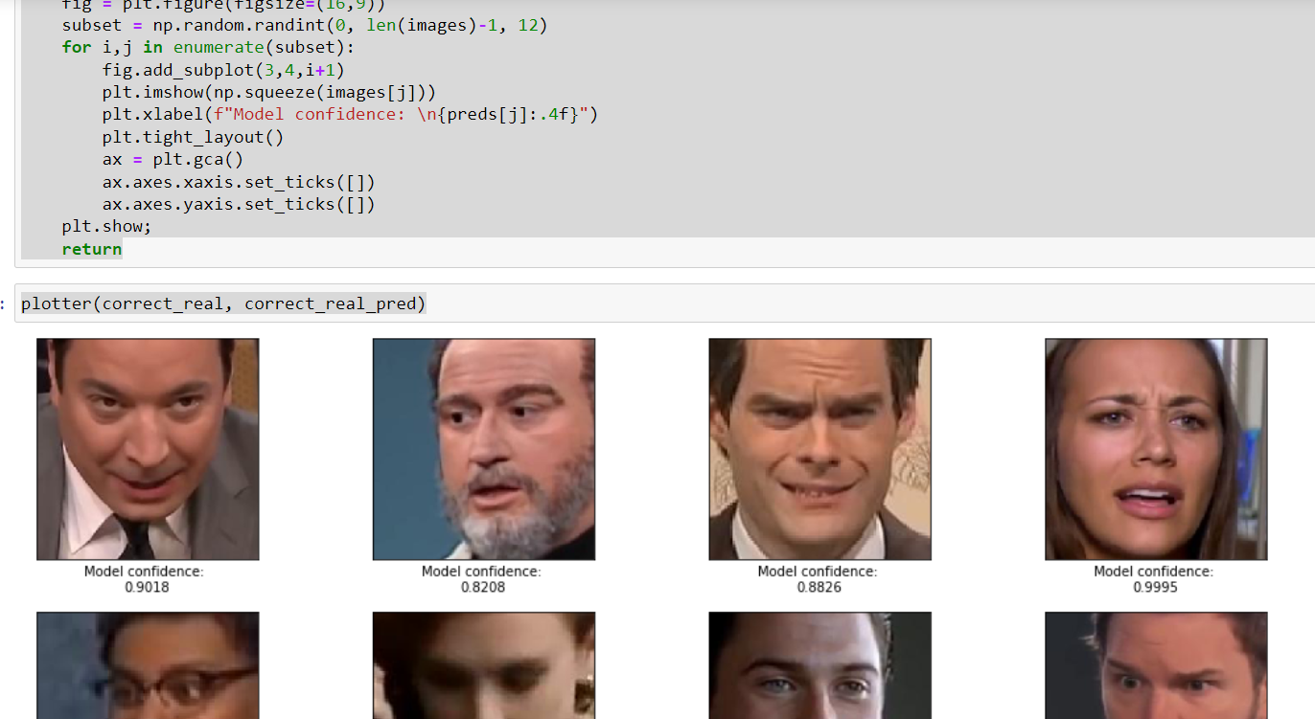
As we have completed our deepfake prediction but we are working on the platform on which we can put deepfake model for the real life use that can help the police to find the real culprits.

Slide 12
How to make the deep fake model live:
Creating a live deepfake model involves deploying the trained deepfake model in a way that allows it to process real-time data, such as video streams or webcam input. The process can vary depending on the framework and tools we used to train our deepfake model.
Choose a Deployment Platform: - Decide where you want to deploy your live deepfake model. This could be on a local machine, a server, or a cloud platform like AWS, Google Cloud, or Azure.
Select a Framework: - Choose a framework or platform that supports real-time inference for your deepfake model.
Convert Model to Inference Format: - Convert your trained deepfake model into a format suitable for deployment.
Build an Inference Pipeline: - Create an inference pipeline that includes pre-processing steps for incoming data, running the deepfake model, and post-processing the results.
Implement Real-Time Processing: - Develop a real-time processing loop that continuously captures frames from the webcam or video stream, processes each frame through the deepfake model, and displays the output.

Slide 13
Future plans: Our future plans are, we want industry experts who can help us and assist in making this project more advance and efficient.
So we are requesting you please help us because we seriously want to work on this and help police for this matter.
Whether our project is good or not but we tried our worked hard to make this model best.
Thank You🙏🤗

